Slide 1
Third nerve palsy
To Vichhey

Slide 2
Outline
Review anatomy
Introduction
Physiopathology
Symptom and sign
Etiology
Differential diagnosis
Work up
Treatment

Slide 3
Notes:
3rd nerve nucleus in midbrain level of the superior colliculus along the vertical midline
Exit the brain through the interpeduncular fossa
Runs along the subarachnoid space and pass between superior cerebella artery (top) and posterior cerebral artery (below)
Runs along the lateral wall of cavernous sinus, divides into 2 branches upon entering the orbit

Slide 5
Introduction
3rd nerve palsy
Rare
Partial or complete
Congenital or acquired
Isolated or associated with other neurological involvements

Slide 6
Physopathology
Can result from lesion from each part of the trajectory of the nerve:
Nucleus
Fasicular
Subarachnoid space
Cavernous sinus
Orbit

Slide 7
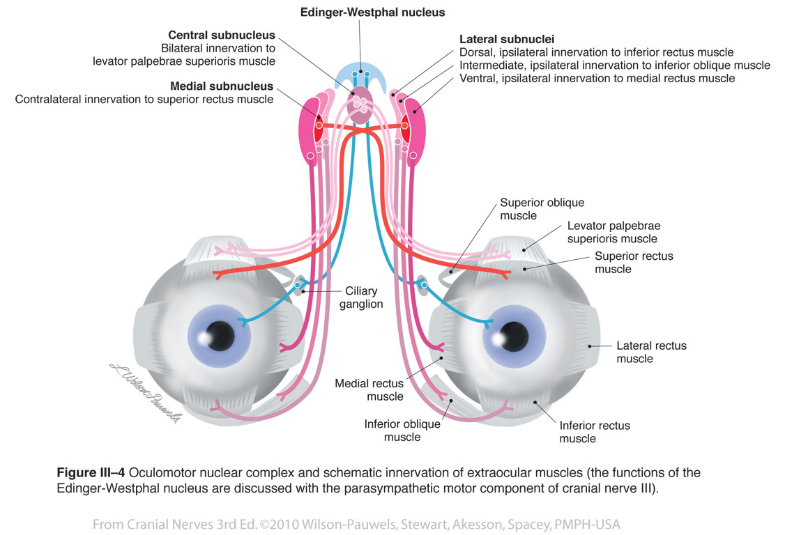
Nuclear complex

Slide 8
Nuclear complex
Cause
Vascular disease
Primary tumours
Metastases

Slide 9
Fasciculus
From the midbrain and pass into the interpeduncular space
Cause
Similar to nucleus’s cause
Benedikt syndrome
Weber syndrome
Nothnagel syndrome
Claude syndrome

Slide 10
Basilar
Pass between the posterior cerebral and superior cerebellar arteries to posterior communicating artery
Commonly : isolated 3rd nerve palsy
Cause:
Aneurysm (posterior communicating artery, at its junction with the internal carotid artery)
Head trauma (extradural or subdural hematoma)

Slide 11
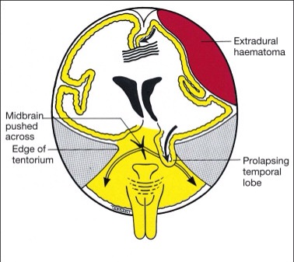
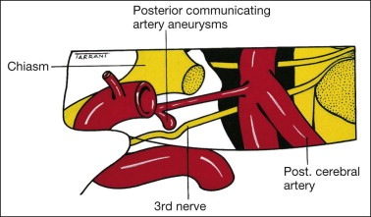

Slide 12
Intracavernous
Enter the cavernous sinus
Anterior part => divide into superior and inferior branches
Cause
Diabetes: cause a vascular palsy (spares the pupil)
Pituitary apoplexy (haemorrhagic infarction)
Intracavernous pathology
Aneurysm
Meningioma
Carotid-cavernous fistula
Granulomatous inflammation (Tolosa-Hunt syndrome)
May involve the 4th, 6th nerves and V1

Slide 13
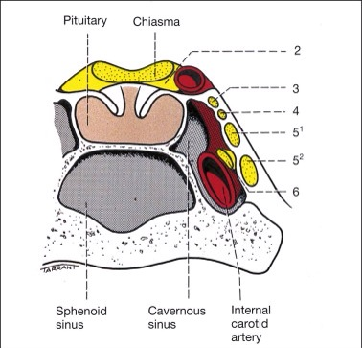

Slide 14
Intraorbital
Superior division innervate the levator and superior rectus muscle
Inferior division innervate the MR, IR and IO muscle
Parasympathetic fibres innervate the sphincter pupillae and the ciliary muscle
Cause
Traumatic
Vascular

Slide 15
Pupillomotor fibres
Between the brainstem and the cavernous sinus
Locate superficially in the superomedial part of the 3rd nerve

Slide 16
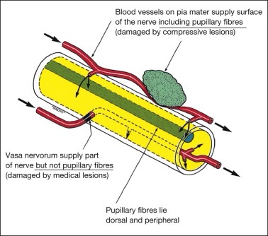
Pupillomotor fibres
Cause
Surgical lesions => invole the pupil
Aneurysms
Trauma
Uncal herniation
Medical lesions => spare the pupil
Hypertension
Diabetes
*Pupillary involvement may be seen in some diabetes associated 3rd nerve palsies
*Pupillary sparing does not exclude aneurysm or compressive lesion

Slide 17
Symptom
Binocular diplopia
Ptosis
With or without pain
Notes:
Weakness of the levator => ptosis
Unopposed action of the lateral rectus => abducted in primary position. SO => intorsion

Slide 18
Signs
External ophthalmoplegia
Complete palsy: limitation of ocular movement in all fields of gaze except temporally
Incomplete palsy: partial limitation of ocular movement
Superior division palsy: ptosis and an inability to look up
Inferior division palsy: Inability to look nasally or inferiorly
Notes:
Weakness of the levator => ptosis
Unopposed action of the lateral rectus => abducted in primary position. SO => intorsion

Slide 19
Signs
Internal ophthalmoplegia
Pupil-involving: a fixed, dilated, poorly reactive pupil
Pupil-sparing: pupil not dilated and normally reactive to light
Relative pupil-sparing: pupil partially dilated and sluggishly reactive to light
Notes:
Weakness of the levator => ptosis
Unopposed action of the lateral rectus => abducted in primary position. SO => intorsion

Slide 20
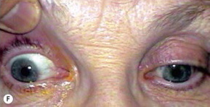
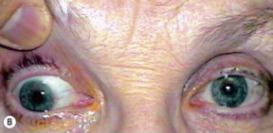
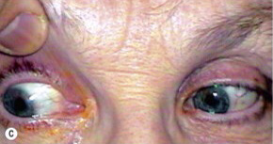
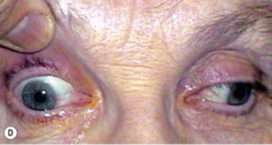
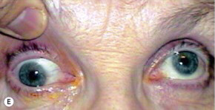
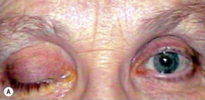
Notes:
Weakness of the levator => ptosis
Unopposed action of the lateral rectus => abducted in primary position. SO => intorsion

Slide 23
Cause of isolated 3rd nerve palsy
Idiopathic: 25%
Vascular disease:
hypertension and diabetes
Pupil-sparing
Recovery occurs within 3 months
Associated with periorbital pain
Aneurysm
Posterior communicating artery
Painful
Pupil involver

Slide 24
Cause of isolated 3rd nerve palsy
Trauma
Common cause
Direct
Secondary to subdural hematoma or uncal herniation
Miscellaneous
Uncommon
Tumours
Syphilis
Giant cell arteritis
Other types of vasculitis associated with collagen vascular disorder

Slide 25
Differential diagnosis
Myasthenia gravis
Thyroid eye disease
Chronic progressive external ophthalmoplegia
Idiopathic orbital inflammatory syndrome
Internuclear ophthalmoplegia

Slide 26
Aberrant regeneration
May follow acute traumatic and compressive 3rd nerve palsy
Cause by misdirection of regenerating axons which reinnervate the wrong extraocular muscle
Bizarre defects in ocular motility
Pupil may also be involed

Slide 27
Work up
History
Onset and duration of diplopia
Recent trauma?
Pertinent medical history (diabetes, hypertension, known cancer, CNS mass, recent infection)
If = 55 years old => GCA symptoms

Slide 28
Work up
Complete ocular examination
Pupil
Ocular movement
VF
Proptosis
Full neurologic examination
Other cranial nerve

Slide 29
Work up
Immediate CNS imaging to rule out mass/aneurysm
Pupil involving
Pupil-sparing
Patient = 50 years of age
Patient with incomplete third nerve palsies
Patients with additional cranial nerve or neurologic abnormalities
Children < 10 years of age
Notes:
Unknown long-standing diabetes or hypertension

Slide 30
Work up
Cerebral angiography
All patients > 10 years of age with pupil-involving third nerve palsies
And whose imaging study is negative or show a mass consistent with an aneurysm

Slide 31
Work up
For suspected ischemic disease
Check blood pressure
Fasting blood sugar
Glycosylated hemoglobine

Slide 32
Treatment
Treat underlying cause
*Especially : aneurysm => refer to neurosurgeon
Medical
Use of Fresnel prisms => small angle of deviation
Uniocular occlusion => avoid diplopia
Botulinum toxin injection into the uninvolved lateral rectus muscle => deviation improve or stabilizes
Surgery
After 6-12 months (may spontaneous improvement)
To treat angle deviation, ptosis and cosmetic

Slide 33
Thank You

